Slide 1

PRESENTING 2020 TASC MIDDLE LEVEL AWARDS

Slide 2



Top Projects
Earth Day COVID Style Buckets of Love
St. Mary Catholic School McCall Elementary

Slide 3

Top Videos
Irons Teacher Appreciation Earth Day COVID Style
Ed Irons Middle School St. Mary Catholic School

Slide 4

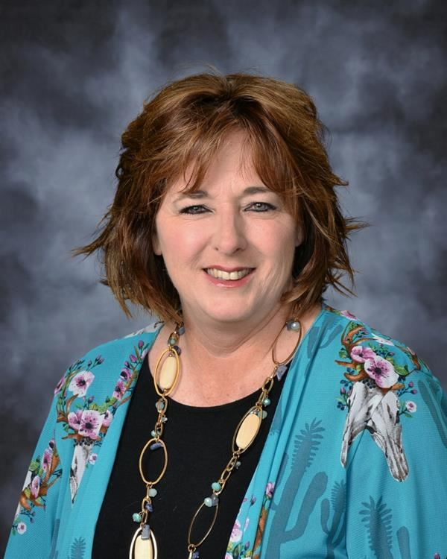
Elected Advisor to the TASC Board of Directors 2020-2023
Shannon Reynolds, McCall Elementary

Slide 5
2020 TASC ML District Advisors of the Year

Slide 6
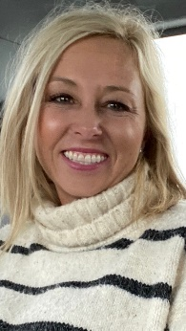
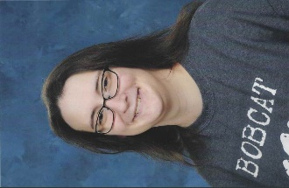
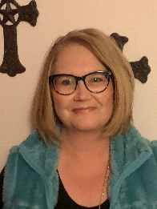
Dist 3 from Dist. 5 from Dist. 17 from
Irma Marsh MS.. Shallowater MS Orangefield JHS
Judy Pastusek Rachelle Hester Robyn Lovett

Slide 7
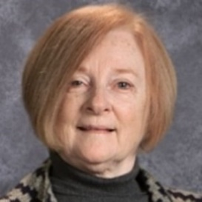
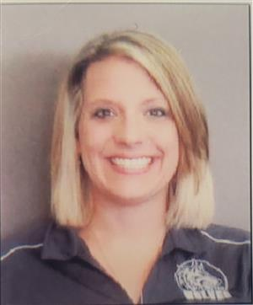
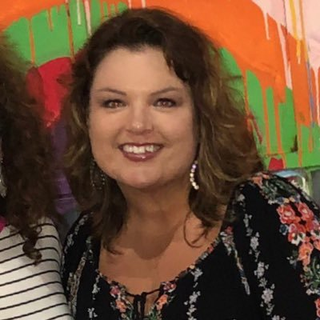
Dist. 4/19 Dist. 1/13 District 12
From Kilgore MS From West Lake MS From Burkburnett MS
Debby Leppert Brittany Templeton Jessica Dobbs

Slide 8
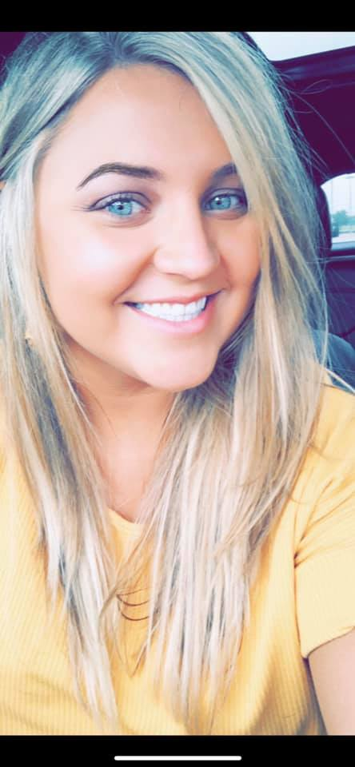

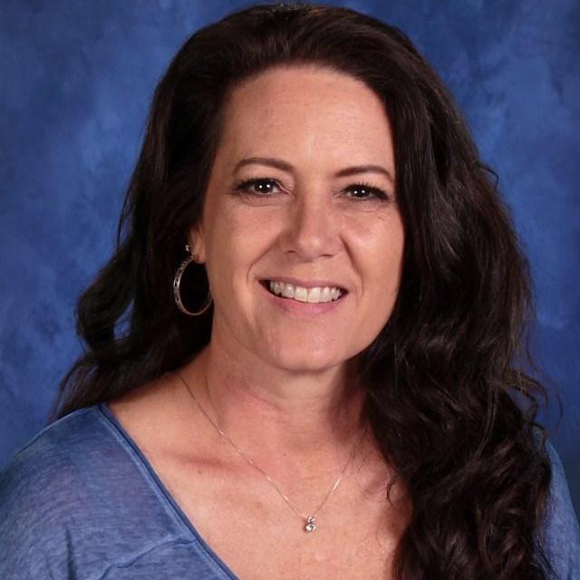
District 14 from District 16 from District 18 from
El Campo MS De Leon MS Burnet MS
Karleigh Krpec Janice Rivera Kim Cozby

Slide 9

2020 TASC Middle Level State Advisor of the Year
From Orangefield Junior High School……..Robyn Lovett

