Slide 1
Red Ribbon Week
2020

Slide 2
Red Ribbon Week 2020
Here's a list of project ideas and how to implement them through virtual, in person, or hybrid schooling as well as how to include every student regardless of their schooling style. Examples and websites are included as well!
Projects included:
Calming rooms pg.4
Group/ virtual exercise pg.5
Stress relief kits pg.6
Vape Awareness pg.8
Drug takeback pg.10
Drinking and driving pg.12
Drug Safety pg.14
Spirit day ideas pg. 15
Other DASH ideas pg.16
Group poster collection pg.17
Click on the page number to skip to that page

Slide 3
Destress.. Yes!
Drugs.. No!
Destressing virtual and in person students during these uncertain times

Slide 4

Virtual/ In person calming room
Click me
In person
  Hold destress time during lunch/ before school in library or stuco classroom
  During finals have stress dogs
  Have puzzles, music, yoga, etc. available
Virtual
  Virtual destress room
    Click here!!
    Click here!!
  Guided meditation, yoga, and group sessions!
    Meditation

Slide 5
Exercise!
In person
  Hold track walks/ runs after school
  Group yoga to destress
  Plan social distanced walk, park clean up
Virtual
  Virtual exercise
    exercise study and tips

Slide 6

Stress Relief Kits
In person/ Virtual
  Create stress release kits for counselors including balloons, fidget toys, bubble wrap, coloring pages,
    other ideas!
  Have virtual students donate items and in person assemble and gift

Slide 7
Escape the vape

Slide 8
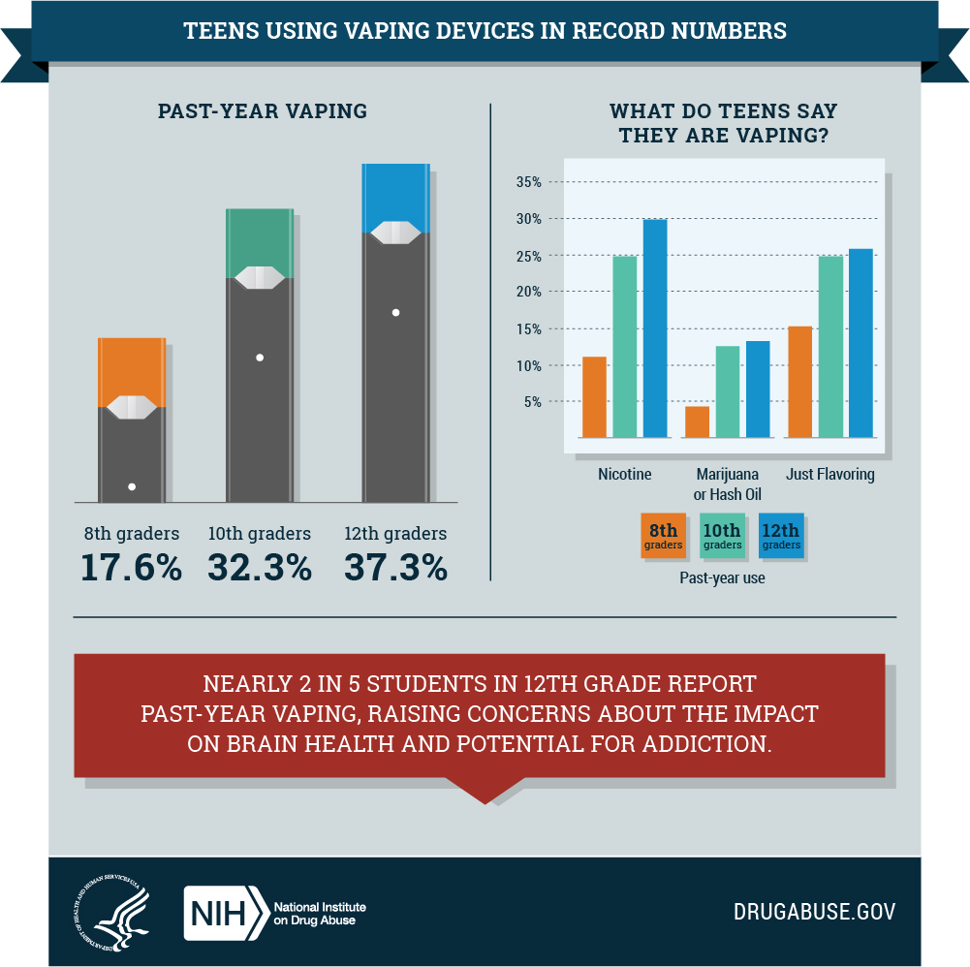
Vape info/ awareness
In person
  Play videos about dangers of vape
    The Real Cost of Vaping
  Make posters with facts and statistics
    Quick facts
    The Truth About Teen Vaping Health Risks
Virtual
  Make online posters to promote on social media
  Post videos and stories relaying the dangers
    Vape facts
    Education and activities

Slide 9
Save lives and the planet

Slide 10
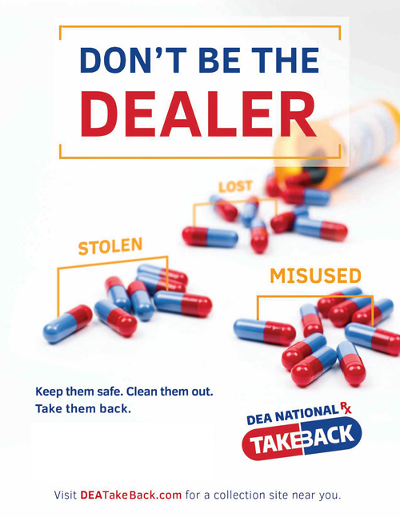
Disposing of drugs properly
In person
  Education
    Why It's Important to Dispose of Drugs Safely
  Drug take back
    Dispose RX available at local grocery stores
    Host take back day for old drugs
Virtual
  Make drug take back awareness posters
  Arrange for drop off/ pick up of old pills to neutralize
    take back info

Slide 11
Stay alive, don't drink and drive
Projects promoting road safety

Slide 12

Drinking and Driving
In person
  Shattered dreams
    a two-day, school-based program that promotes responsible decision-making among high school students regarding underage drinking and impaired driving by showing them how irresponsible choices can end all dreams.
  Drunk driving goggles
  Place sheets on cars before holidays like halloween and other times of year prone to parties
    “Stay alive don't drink and drive” “drinking and driving is a gamble you can't win” “friends don't let friends drive drunk” “
Virtual
  Virtual drunk driving simulator
    Online Simulator
  Posters and social media campaign promoting alcohol free driving and lifestyle
    info/ awareness

Slide 13
This is my natural high
Advocate on the dangers of drug abuse and pair with spirit day

Slide 14

Drug safety
In person/ Virtual
  Drug awareness kahoot
    drug awareness kahoot
  Drug awareness jeopardy
    drug abuse jeopardy
  Educational bingo
    Bingo
Justin Bieber discussing addiction

Slide 15
Spirit day ideas
Destress.. Yes! Drugs.. No!
Save lives and the planet
Escape the Vape
Stay alive don't drink and drive
This is my natural high
Comfy clothes/ pajama day
Super hero day
Decades day, spy day
Black out
School pride day

Slide 16
Other Dash Project ideas
Mental health
Clothespin positivity
Remembering those lost to suicide
Suicide prevention week
Domestic abuse awareness posters
Love is, project during february (recognize signs for healthy vs unhealthy relationships)
Take what you need wall
Friendship bracelet station
Honk if your happy
Driving Safety
Seat Belt sashes
Leave “tickets” sheets on windshield reminding on dangers of speeding and texting while driving
“Don't be a Dum Dum, Don't text and drive”, pass out dum dums
Safe2Save (Great app!!!)

Slide 17
In school/ virtual awareness poster ideas/
Consent
Abuse signs
Drug/ alcohol abuse
Safe driving
Hotlines
Speaking up
Teaching on consent and how necessary it is
Recognizing the signs of emotional, physical, and mental abuse
Reminding on the dangers of substance abuse and including statistics
Reminding teens to not text or drink while driving
Supplying each hotline for teens in need
Promoting speaking up on potentially dangerous situations and how to get help

Slide 18
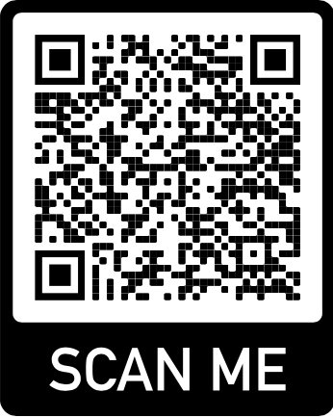
Drive link/QR code for poster ideas
ADD OR VIEW POSTER IDEAS!!
https://drive.google.com/drive/folders/1mk2QYHCN1yglMNmvlGFTRuNqPG3Ydqy1?usp=sharing

Slide 19
Thank you
Any other questions email
chloewilliamsk@gmail.com

