Slide 1





TASC State Service Project
Lianna Gantz

Slide 2
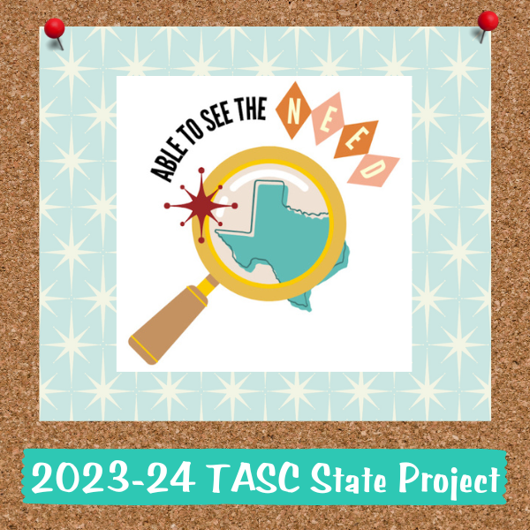
Project Overview
  Student Developed
  Return to basic needs
Providing accessible resources to combat the overall lack of basic necessities in our schools and communities.

Slide 3
Goals
1
2
3
SEE THE NEED
Connect with our communities to identify needs
EDUCATE
Volunteer groups with opportunities.
Those in need regarding resources available.
CONTRIBUTE
Volunteering
Drives
Resources
More goal specificity found on the TASC website.

Slide 4
Why?
This platform...
  Serves the underprivileged by making necessary resources easily accessible
  Allows every council to pitch into this project in a variety of ways
  Members of any community are in need of bare necessities
  It affects more people than you realize...

Slide 5
What do you already do?
  Canned food drives
  Clothing drives
  Volunteering at food banks
  Holiday meals
  Etc.

Slide 6
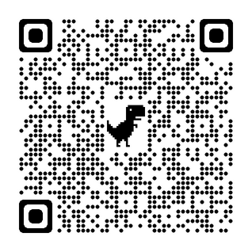
Possiblities
  Work with a local advocacy center
    Search by “county advocacy center”
  Partnerships
    United Way, Texas Homeless Network
  Food bags to go (on campus)/Food Pantry
  Hygiene drives
  How-to Videos (life skills)
  Day of Service
  Etc.

